Slide 1


LIFEGUARD: Saving the Network Outage Hassle with the HOFF
Colin Scott
With Professor Ethan Katz-Bassett, Dave Choffnes, Italo Cunha,
Arvind Krishnamurthy, and Tom Anderson
Notes:
Thanks everyone for coming. As part of my thesis, I’m going to argue to you today that the Internet is broken, and that we did to help fix it with the HOFF.

Slide 2
A Quick Survey
Raise your hand if you used the Internet / email:
…since you got to this room?
…in the last hour?
…today?
Notes:
At this point, I’m going to assume anyone with hand down is too busy checking email to have heard the question
My point is that we all depend on the Internet

Slide 3
We need the Internet to be reliable
We increasingly depend on the Internet:
Yesterday: Email, web browsing, e-commerce
Today: Skype, Google Docs, NetFlix
Tomorrow: Thin clients + cloud services, outpatient medical monitoring,…
So, we expect it to be highly available.
Does it achieve this goal?
Notes:
Traditional apps like email and web browsing. E-commerce sites rely on the Internet’s reliable operation for their business
Now, we use to access data and apps in the cloud, to watch movies, and to talk on the phone. We want our cloud data to be reliably available, and we want our movies and phone calls to be smooth
Have to hang up multiple times and retry call
We’re moving towards a world where we’re much more dependent on the Internet
Future: most apps are in the cloud, most communication is over the Internet, want to run critical services
For these apps, we have to be able to rely on the Internet
Are we ready for that?
I’m going to show you that the current answer is no, but that we can take concrete steps towards improving it
What’s the current situation?

Slide 4
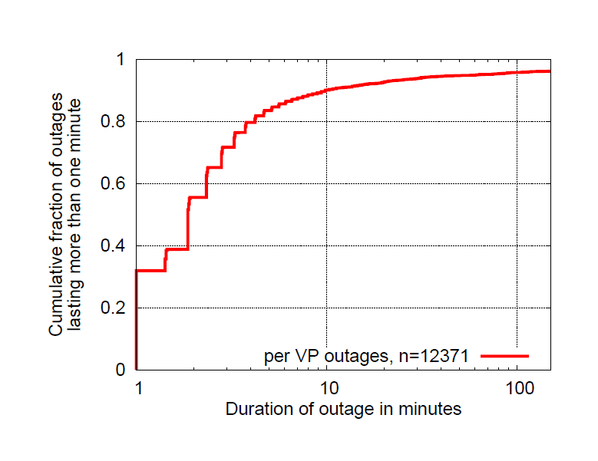
Lots of long-lasting outages
4 EC2 instances monitoring 250 targets
12,371 outages over one month
~10% lasted longer than 10 minutes
Notes:
Motivate with internship story.
Emphasize Not during my internship.
This motivated us to study EC2 more in depth.
How this is different from public studies. EC2, holy shit!
US-WEST, US-EAST, EU-WEST, Singapore
sending pings to 250 targets from the top 50 ISPs
ranked according to UCLA's topology data
one measurement round every 60 seconds

Slide 5
Most are partial
Approx 80% are partial
Number of vantage points
Notes:
Same outages as previous. Bucketing by VP. -> conclusion
And they’re partial, which means we can do something about it!

Slide 6
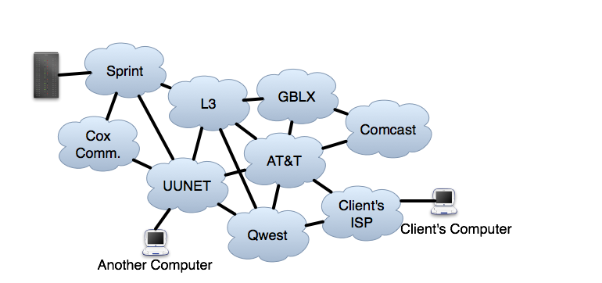
But where are the outages?
Anywhere along the path
State of the art: traceroute
Gives an incomplete view
Amazon
Server
Notes:
Tie back to anectode. Clients everywhere, don’t have visibility, don’t have control, still need to fix
Diagram -> two different paths. (Partial reachability.)
Show Amazon. Show a client. Show asymmetry.
Cut the other computer

Slide 7
Example confusion (12/16/10)
“It seems traffic attempting to pass through Level3's network in the Washington, DC area is getting lost in the abyss. Here's a trace:”
– Outages.org list
User 1 1 Wireless_Broadband
2 BLTMMD.verzion.gni.net
3 PHIL.verzion-gni.net
4 IAD8.ALTER.NET
5 washington.dc.level3.net
6 * * *
User 2
1 192.168.1.1
2 washdc.verizon.gni.net
3 iad3.alter.net
4 washington.dc4.level3.net
5 chicago2.level3.net
6 denver1.level3.net
7 * * *
User 1: Broken link is in DC
User 2: Broken link is in Denver
Is this even the same problem?
Notes:
Now actual outage where operators were confused
Put on same slide

Slide 8
Goal
Detect and isolate outages in real time
Provide diagnostic information to operators
Notes:
Not fixing themselves
: requires path diversity, no stub Ases
: outages in PoPs affecting many paths
Bullet Points
Relate to AMZN graphs. Partial outage imply that alternate routes exist.
Structure

Slide 9
Solution: LIFEGUARD
LIFEGUARD: Locating Internet Fault Events and Generating Usable Alternate Routes Dynamically
Remainder of this talk:
System implementation
Background: traceroute
Evaluation
Measurement study
Notes:
List of questions that we’re trying to answer. Beyond what traceroute tells you.
Direction

Slide 10

Solution: LIFEGUARD
Detect Outages with the HOFF: the High-impact Online Failure Finder
Key techniques:
Multiple vantage points
Spoofed pings + spoofed traceroute
Reverse traceroute
Historical path atlas
LIFEGUARD provides:
(Working) direction
View into paths before outage (alternate working paths)
Location of failure

Slide 11


Background: traceroute
TTL=1
Source
Target
Source

Slide 12
Background: traceroute
R1
R1: Time Exceeded
Source
Target

Slide 13
Background: traceroute
R1
TTL=2
Source
Target
Notes:
Describe what R1 is. What S and T are.

Slide 14
Background: traceroute
R1
R2
R2: Time Exceeded
Source
Target

Slide 15
Background: traceroute
R1
R2
R1
TTL=3
Target
Source
Target

Slide 16

Background: traceroute
R1
R2
R1
Target
Source
Target
?
Notes:
Relate back to traceroute example.. This is what we saw earlier, trails off…

Slide 17
Background: traceroute
?
X
R1
R2
R1
Target
Source
Target
Notes:
It might be in the forward direction…

Slide 18
Background: traceroute
R1
R2
R1
X
Target
Source
Target
?
Notes:
Getting somewhere!, but failing on the way back
Like in L3 example
Insert additionaln information we want here. With the architecture diagram.

Slide 19
Solution: LIFEGUARD
Key techniques:
Multiple vantage points
Spoofed pings + spoofed traceroute
Reverse traceroute
Historical path atlas
LIFEGUARD provides:
(Working) direction
View into paths before outage (alternate working paths)
Location of failure

Slide 20
Isolating the direction
S’
R1
R2
R1
Ping?
Source: S’
Target
Source
Target
Spoofing: pretending you’re another computer
Notes:
What is spoofing?
Pretend we’re someone else, trick the router
Text

Slide 21
Isolating the direction
Target: Pong
S’
R1
R2
R1
Target
Source
Target
Spoofing: pretending you’re another computer

Slide 22
Isolating the direction
Ping?
Source: S
S’
R1
R2
R1
Target
Source
Target
Spoofing: pretending you’re another computer

Slide 23
Isolating the direction
S’
R1
R2
R1
Target
Source
Target
Target: Pong
Spoofing: pretending you’re another computer

Slide 24
Measuring the working direction
S’
R1
R2
R1
TTL=3
Source: S’
Target
Source
Target
Reverse path failure: use spoofed forward traceroute
Notes:
Moving to a different question now. What does working direction look like?

Slide 25
Measuring the working direction
R3: Time Exceeded
S’
R1
R2
R3
R1
Target
Source
Target
Reverse path failure: use spoofed forward traceroute

Slide 26
Measuring the working direction
R4: Time Exceeded
S’
R1
R2
R3
R1
R4
Target
Source
Target
Reverse path failure: use spoofed forward traceroute

Slide 27
Measuring the working direction
Target: Pong
S’
R1
R2
R3
R1
R4
Target
Source
Target
Reverse path failure: use spoofed forward traceroute

Slide 28
Isolating the fault
S’
R2
R3
R1
R3
R1
R4
X
R4
Target
Source
Target

Slide 29
Isolating the fault
S’
S’
R2
R3
R1
R3
R1
R1
R1
R4
R4
Target
Target
Target
Source
Target
R5
Measure working paths with reverse traceroute

Slide 30
Isolating the fault
S’
S’
R2
R3
R1
R3
R1
R1
R1
R4
R4
Target
Target
Target
Source
Target
R5
X
OK, somewhere on R3’s reverse path
But where?

Slide 31
Tracking paths before the outage
Each host traceroutes each target
VPs
Targets
Notes:
How often do paths change? Not that often… which is why this is helpful

Slide 32
Tracking paths before the outage
Each host measures reverse paths
VPs
Targets

Slide 33
Isolating the fault
S’
R1
R2
R3
R1
R4
Target
Source
Target
R8
R5
R6
R7
View into historical paths
Notes:
Show

Slide 34
Isolating the fault
S’
R1
R2
R3
R1
R4
X
Target
Source
Target
R8
R5
R6
R7
Ping?
Issue pings to infer reachability
Notes:
Show forward failure first. Answer questions. Then introduce more complicated reverse case. Same pieces, solve the same problem
Show ping animations. Emphasize what colors mean, edges, etc.

Slide 35
Measuring the working direction
S’
S’
R2
R1
R2
R1
R1
R1
Target
Target
Target
Source
Target
Source
R8
R5
R6
R7
Forward path failure: use reverse traceroute

Slide 36
Isolating the fault
S’
X
S’
R2
R1
R2
R3
R1
R1
R1
R4
Target
Target
Target
Source
Target
Source
R8
R5
R6
R7
Forward path failure: near last hop of traceroute

Slide 37
Putting it all together
LIFEGUARD:
Finds spoofing VPs that reach target
Determines and measures working direction (if any)
Forward: issue spoofed forward traceroute
Reverse: VPs spoof towards target as source, issue spoofed reverse traceroutes
Provides a view into historical paths
Isolates the failure
Forward-only: spoof traceroute
Reverse-only: reverse traceroute from each fwd hop, ping historical hops
Bi-directional: spoof traceroute
Notes:
In the context of those questions

Slide 38
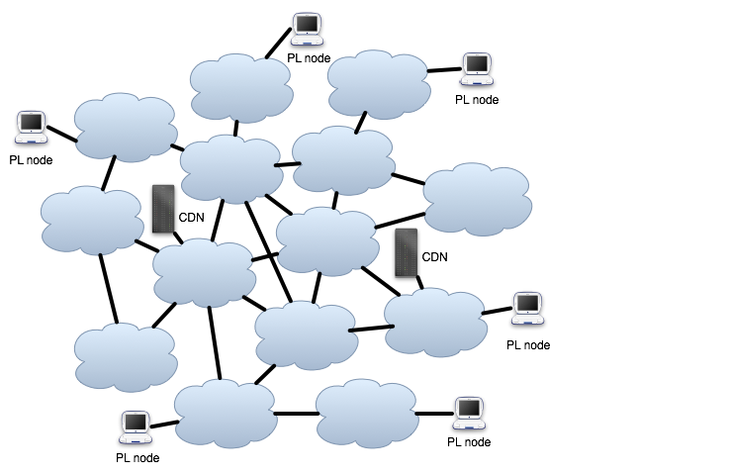
Deployment
LIFEGUARD has been running for 4 months
12 PlanetLab VPs
monitoring:
73 other PL nodes
83 core routers
185 edge routers
16 CDN nodes
Notes:
Monitor between first,
Then CDN
Blah
Blah
Why we chose them

Slide 39
Evaluation
May 24th at 11:39pm, two vantage points identified
ae3-3.erb1.Chicago2.Level3.net as a suspected failure.
Outages.org:
“Saw issues routing through Chicago via Level3 starting around 11:05pm, cleared up about 11:43pm.”
Confirmed by other operators
Notes:
So we just talked about system, now we’ll look at how well it works
We find real failures…
After, walk through a few examples

Slide 40
Evaluation
Observed 778 filtered outages over four months
Last hop of traceroute differed from suspected failure for 30% of outages
Direction:
Isolate the failure to either the forward or reverse path for 53%
Measure the full opposite direction for 63% of uni-directional
Provide historical path information:
for >80%
Identify alternate working paths for 49%
Notes:
Illustration with real example
Make sure to motivate alternate working paths.
Distinction between traceroute, rest is what we provide

Slide 41
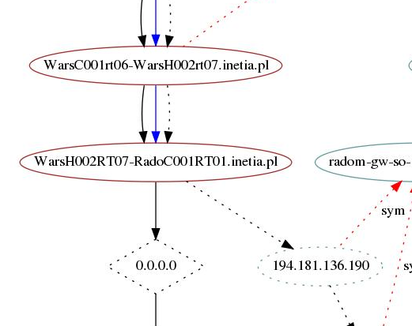
What did we find?
Forward/Bidirectional Outages
Category | Count
Next hop unreachable | 195
Path Change | 163
Next hop reachable | 229
Horizon confined to AS | 10
Horizon crosses domains | 22
Multi-homed Provider link | 37
Missing historical reverse path | 137 (oops!)
Next hop unreachable
Notes:
Implications of these numbers!

Slide 42
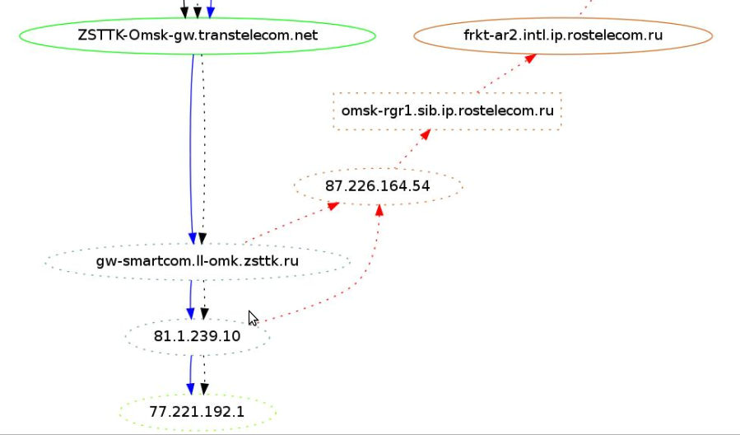
What did we find?
Reverse Path Outages
Category | Count
Next hop unreachable | 195
Path Change | 163
Next hop reachable | 229
Horizon confined to AS | 10
Horizon crosses domains | 22
Multi-homed Provider link | 37
Missing historical reverse path | 137 (oops!)
Horizon Confined to one AS

Slide 43
Future Work
Correlate across vantage points, destinations, and time
Improvements: choose targets more rigorously, verify that alternate working paths are valid
PAMELA: Poisoning Ases for Machiavellian Event Location Avoidance
LIFEGUARD II: When the HOFF identifies an outage, PAMELA steers traffic to safety
Scale to the Internet! Get network operators to use it!
Notes:
Pamela explanation

Slide 44
Summary
Novel study of EC2 network connectivity
Real system for wide-area fault isolation
Large-scale outage monitoring
Infer/measure working direction
Spoofed pings / traceroute
View into routing before outages
Historical, rapidly refreshed path atlas
Algorithm for isolating failures
Pings to infer reachability
Notes:
Motivation as part of summary
-> Study

Slide 45
Questions?

Slide 46
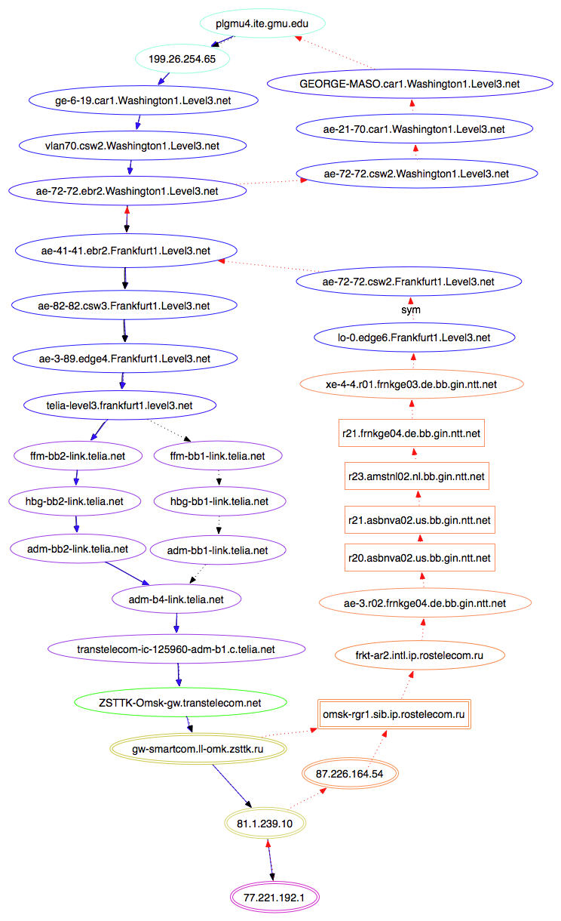
Notes:
Condense

